Slide 1

Graduation Project car object detection

Slide 2
Agenda
Introduction
YOLOv8m.pt for Car Detection
Web App
Integration with Web App
Results and Evaluation
Conclusion and Future Work

Slide 3

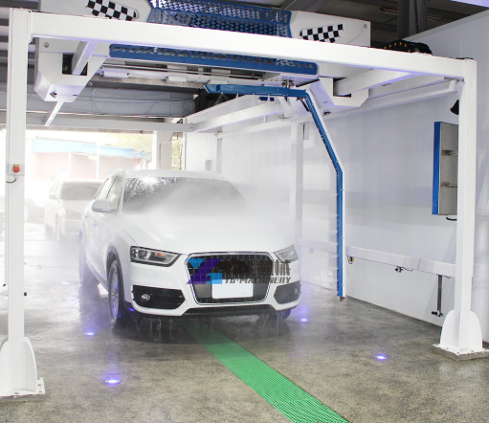
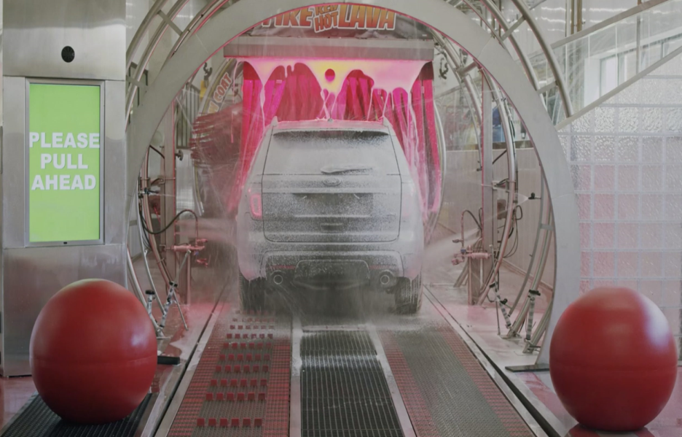
Introduction
The YOLOv8m.pt model is utilized in the app to differentiate between images of cars and trucks, enabling it to prepare the appropriate location and time for each vehicle type.

Slide 4
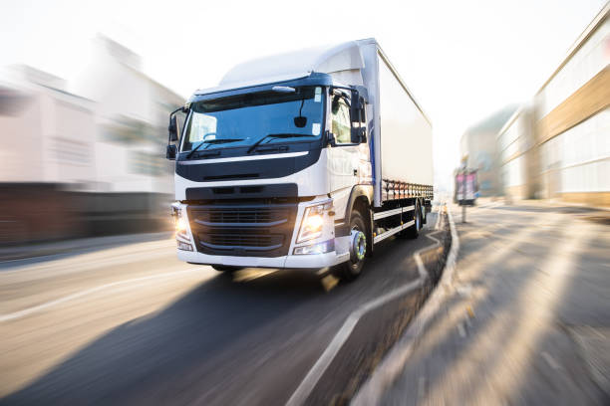
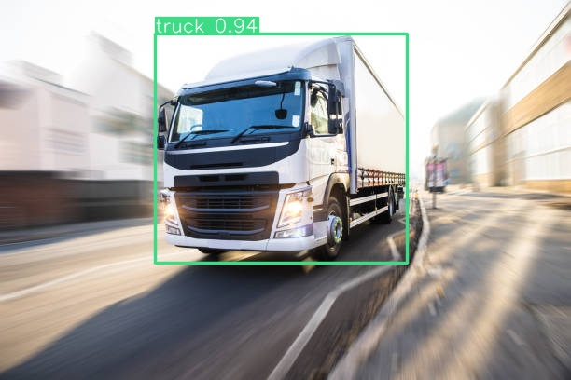
YOLOv8m.pt for Car Detection
Ultralytics YOLOv8 is the latest version of the YOLO (You Only Look Once) object detection and image segmentation model developed by Ultralytics.
The YOLOv8 model is designed to be fast, accurate, and easy to use, making it an excellent choice for a wide range of object detection and image segmentation tasks. It can be trained on large datasets and is capable of running on a variety of hardware platforms, from CPUs to GPUs.

Slide 5
Web App
Technologies use for building a web app:
HTML, CSS, and JavaScript: for building the frontend of a web app
Backend Frameworks: Backend frameworks like Flask
Databases: MySQL

Slide 6
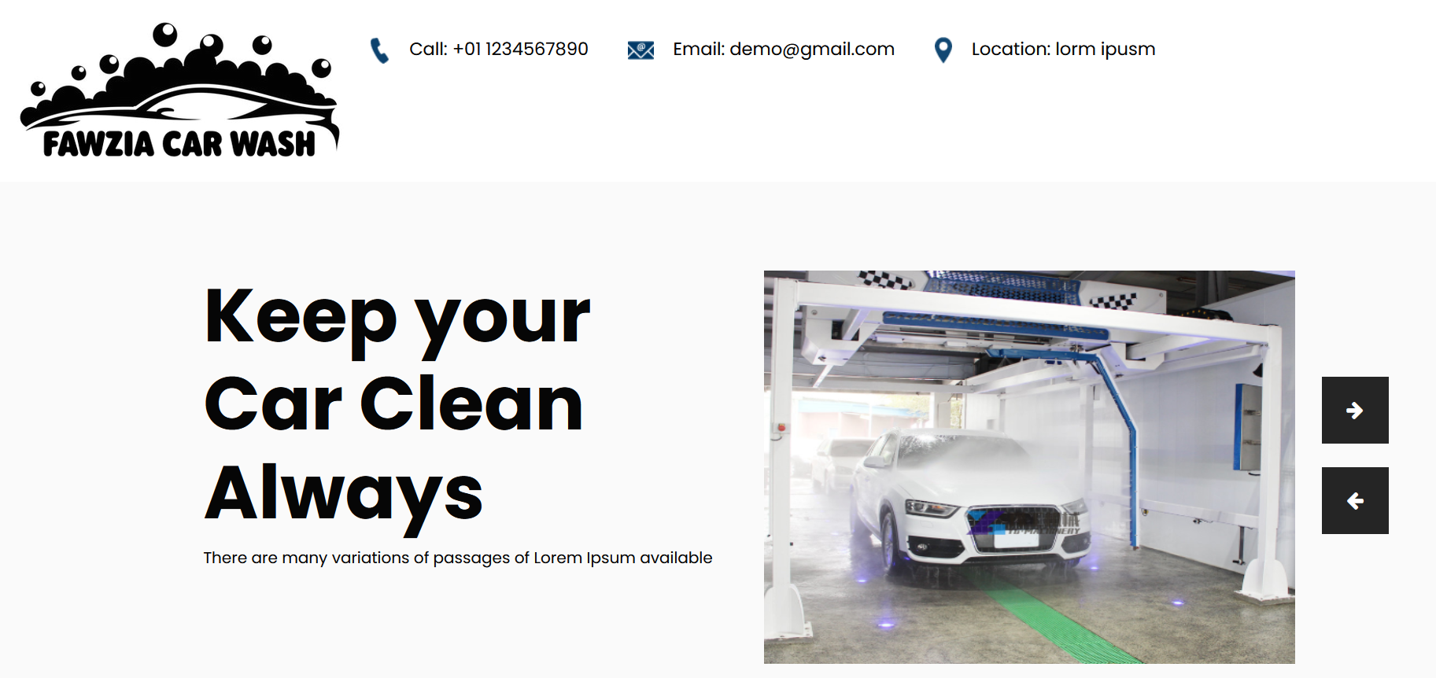
Web App

Slide 7
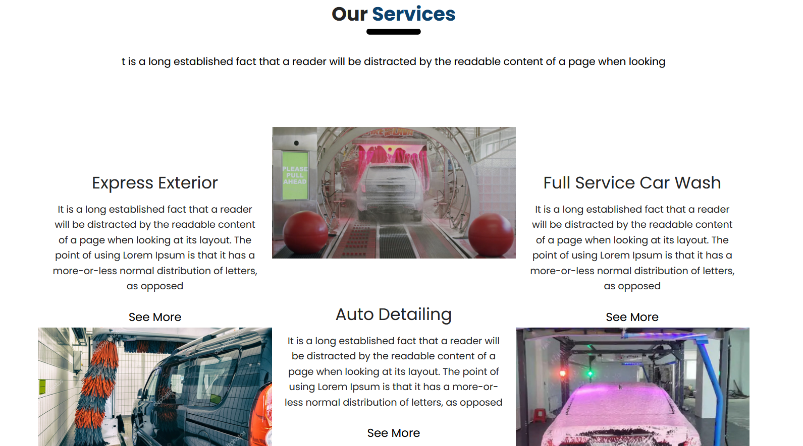
Web App

Slide 8
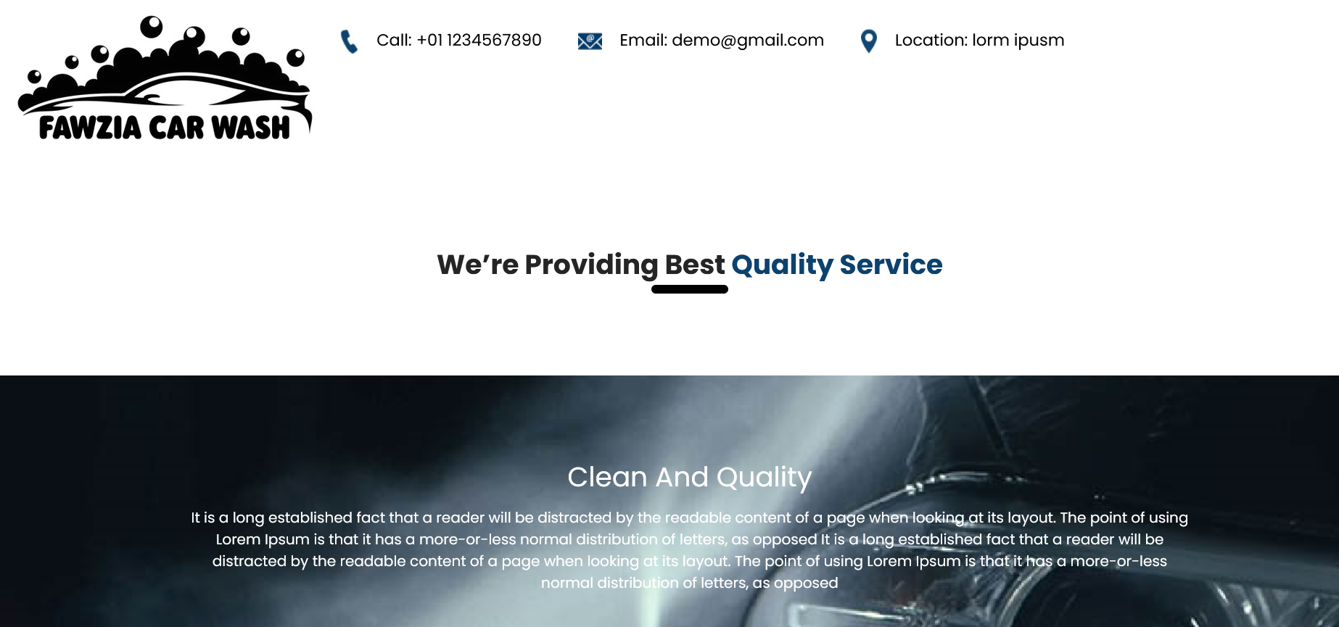
Web App

Slide 9
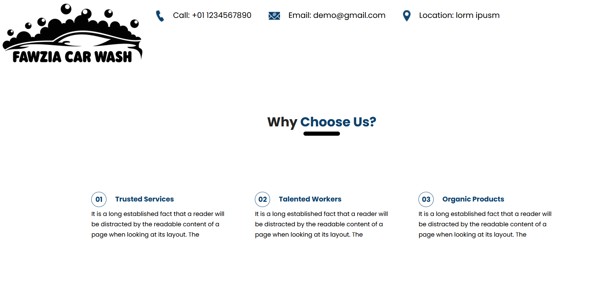
Web App

Slide 10

Web App

Slide 11
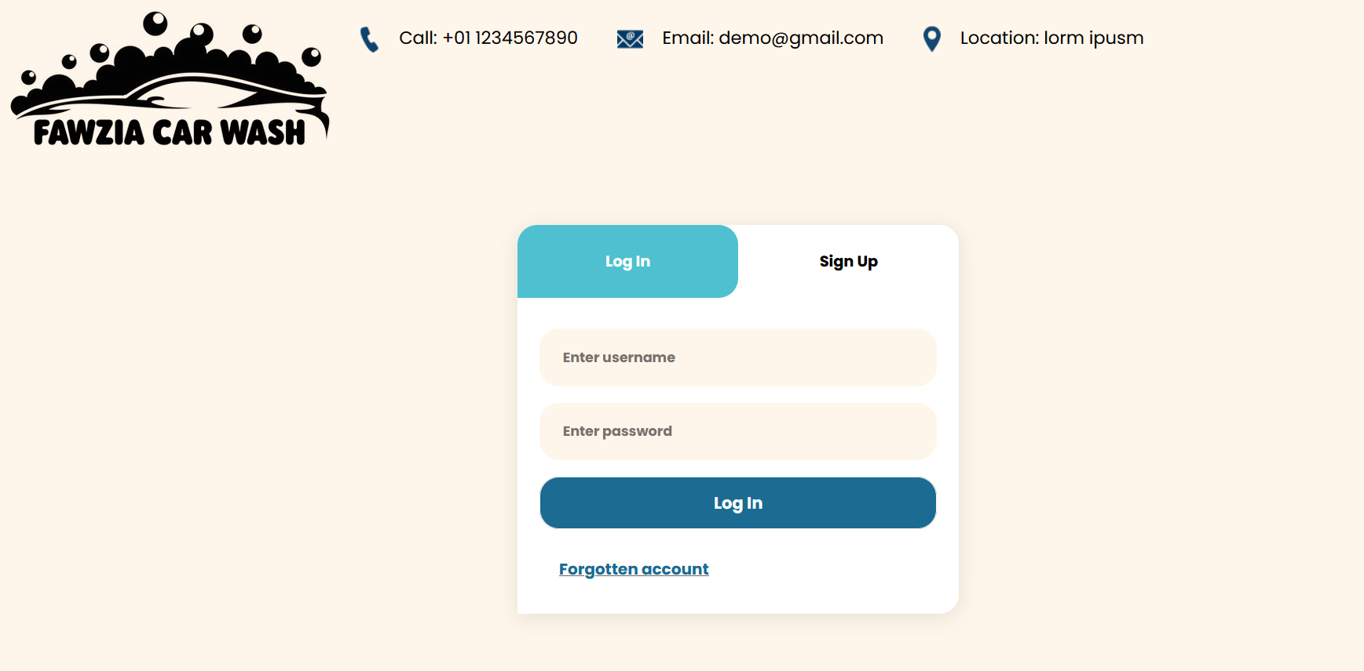
Web App

Slide 12
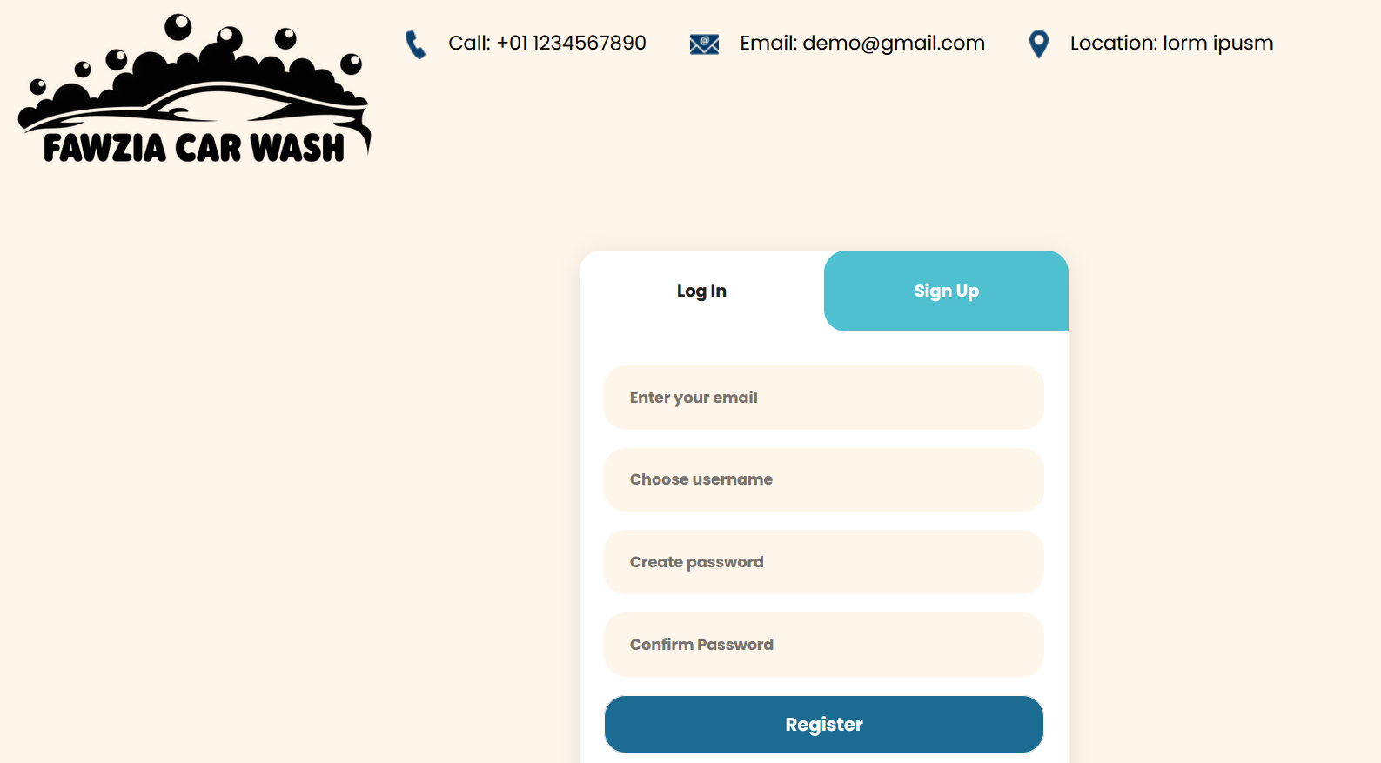
Web App

Slide 13
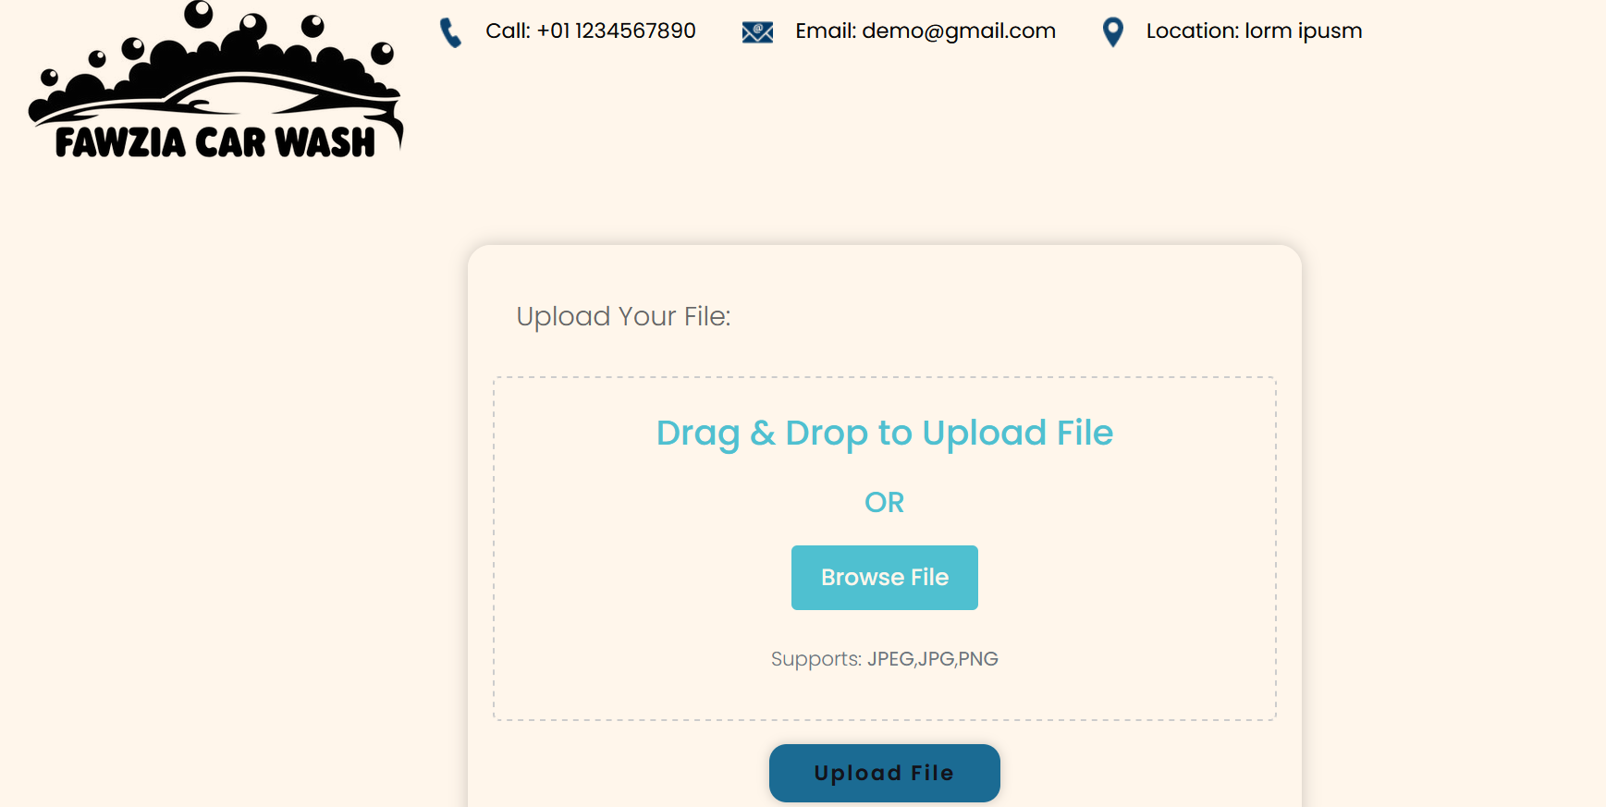
Web App

Slide 14
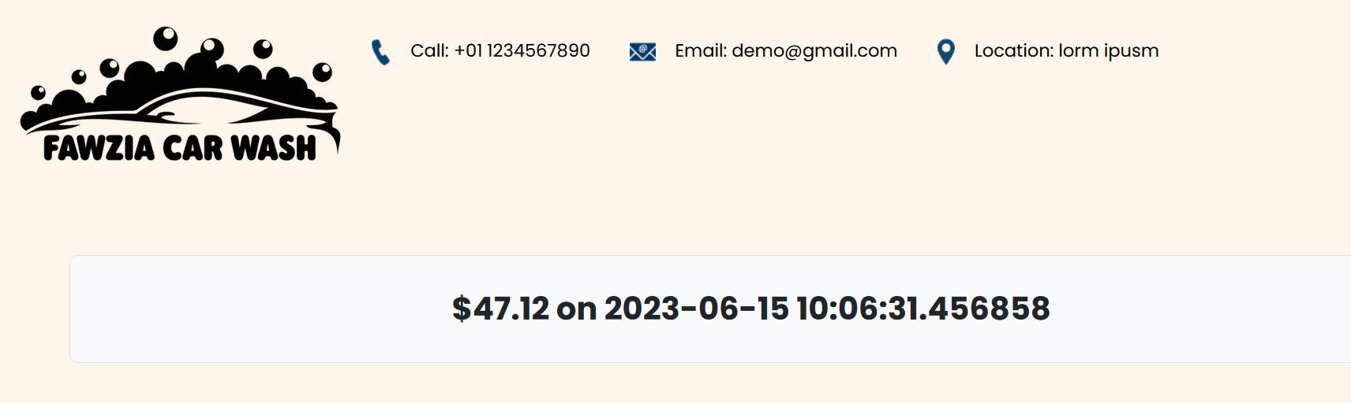
Web App

Slide 15
Web App
Link to Database>>>
https://www.db4free.net/phpMyAdmin/index.php?route=/&route=%2F
username
freetestdemo
pasword
cleopatra2023

Slide 16
Integration with Web App
Flask is a flexible and lightweight web framework for Python that is ideal for building APIs.
Our AI model is integrated with the web app using a Flask API, which allows the web app to communicate with the model and get predictions.
We used Flask's request object to retrieve the input data from the web app and pass it to the AI model for processing.

Slide 17
Results and Performance Evaluation
Our web app utilizing AI and computer vision to detect whether a vehicle is a car or truck has been successfully deployed and tested.
The integration of the AI model with the web app using Flask has improved the efficiency of the car wash by reducing the time taken to manually classify the vehicles.

Slide 18
Conclusion and Future Work
User feedback has been overwhelmingly positive, with customers appreciating the accuracy and speed of the web app in determining the price for the wash.
Our future work includes improving the accuracy of the AI model by incorporating more training data and fine-tuning the model parameters.
We also plan to expand the web app's features to include personalized recommendations for customers based on their vehicle type and wash history.
Additionally, we will explore the integration of payment gateways to enable customers to pay for their wash online, making the process even more efficient and convenient.

Slide 19
Thank You

